Slide 1

PwC Switzerland Virtual Experience Program on Forage
By Marco Hui
Last Updated: 6th Feb, 2023

Slide 2
Acknowledgment
Big thanks to PwC and Forage, it was a wonderful experience working on the PwC Power BI in Data Analytics Virtual Case Experience provided by Forage. I can get a taste of what interns at PwC may work on in relation to data visualization and analysis. It was amazing at working on cases and having experience with real-life problems. I helped with quick business decisions by sharing insights from the data, excited to participate more in the future.
2

Slide 3
Background
I joined the team and Giulia is my manager and helps me through my upskilling journey in Power BI.
I had to finish 3 tasks in this program:
Visualizing customer and agent behavior of call center.
Customer demographics and insights.
Gender balance in the executive suite.
2

Slide 4
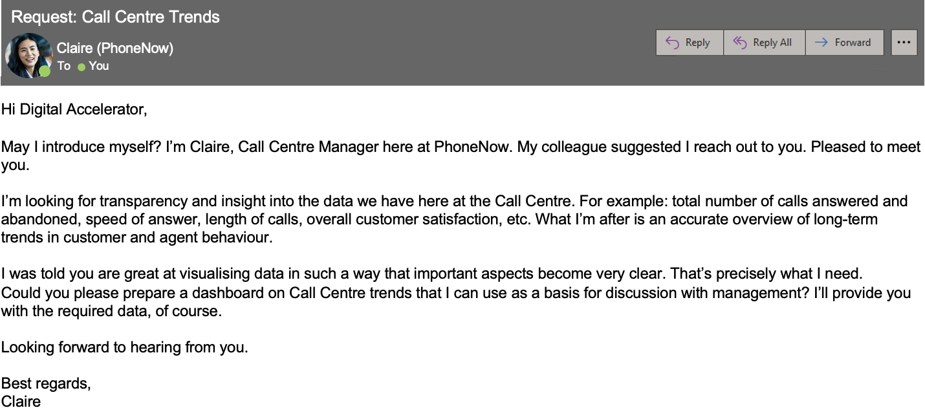
Task 1
An important client reached out to me to help him visualize their data.
Key stakeholders: Claire (Call Center Manager) at PhoneNow, Giulia (my manager)
Business Task: Prepare a dashboard on Call Center trends.
3

Slide 5
Business Task
For the dashboard, elements that Claire wanted to include:
Total number of calls answered and abandoned
Speed of answer
Length of calls
Overall customer satisfaction
Agent’s performance quadrant
Overview of long-term trends in customer and agent behavior
4

Slide 6
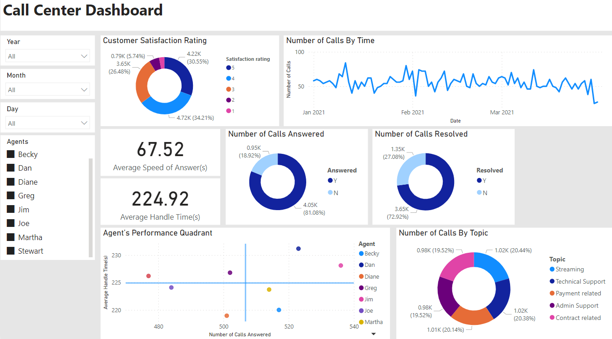
Call Center Dashboard
5

Slide 7
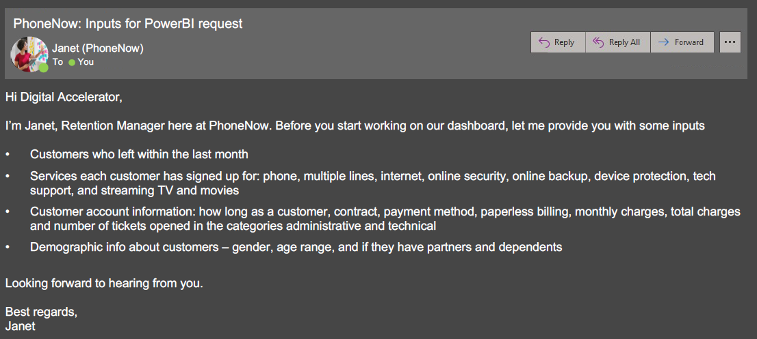
Task 2
A few weeks after presenting the dashboard to the management, the Retention Manager from the telecom reaches out to me directly and asked if I can put together a dashboard about customer retention.
Key stakeholders: Janet (Retention Manager) at PhoneNow, Giulia (my manager)
6

Slide 8
Business Task
Customers in the telecom industry are hard-earned: we don’t want to lose them.
The retention department is here to get customers back in case of termination.
Currently, we get in touch after they have terminated the contract, but this is reactionary: it would be better to know who is at risk in advance.
We have done customer analysis with Excel: but it has always ended in a dead-end.
We would like to know more about our customers: visualized clearly so that it’s self-explanatory for our management.
7

Slide 9
Dashboard Elements
Based on the datasets Janet provided, I created the dashboard with 3 pages:
Customer Retention Board: Included KPIs
Customer Services Board: Included services each customer has signed up for
Customer Account Board: Included customers’ demographic and account information
8

Slide 10
Dashboard Elements
Referring to the article “10 Customer Retention Metrics & How to Measure Them”, I defined the following KPIs:
Customer retention rate
Customer churn rate
Monthly recurring rate
Monthly revenue churn
MRR (monthly recurring revenue) growth rate
Monthly revenue churn rate
Average subscription length
Average customer lifetime value
9

Slide 11
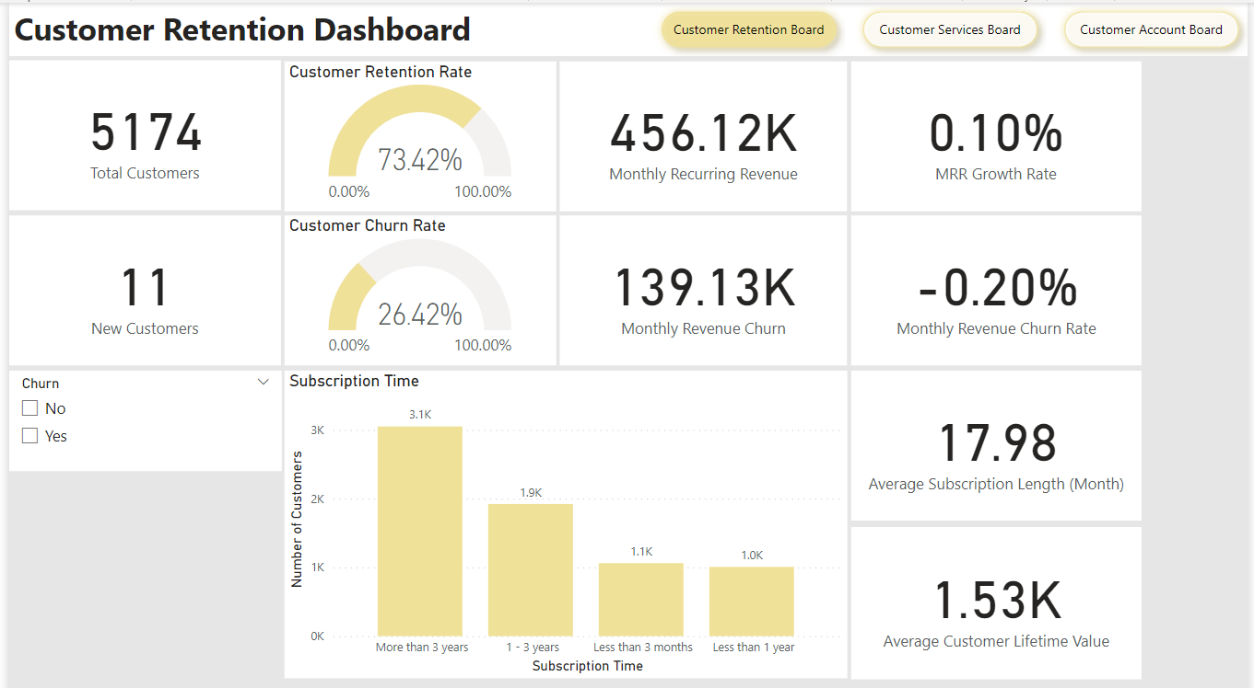
Dashboard Elements
10

Slide 12
Customer Retention Board
11

Slide 13
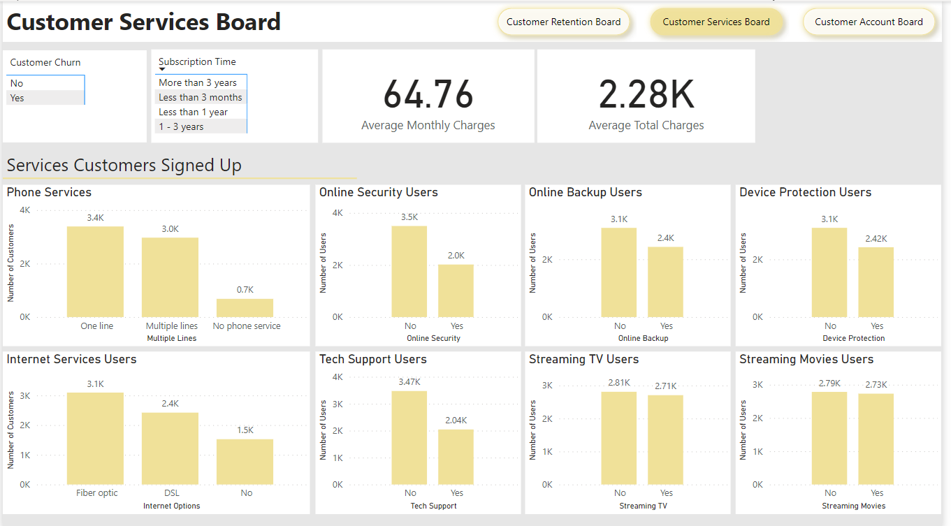
Customer Service Board
12

Slide 14
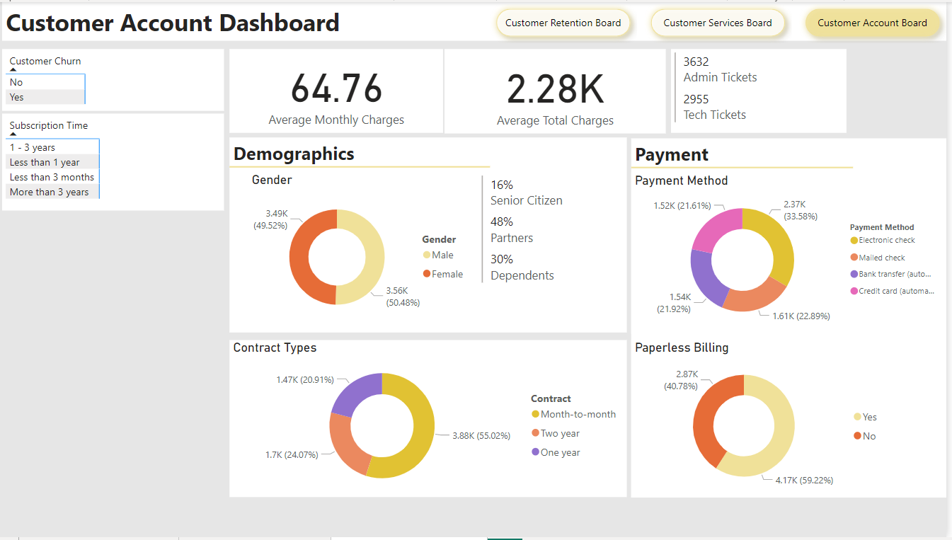
Customer Account Board
13

Slide 15
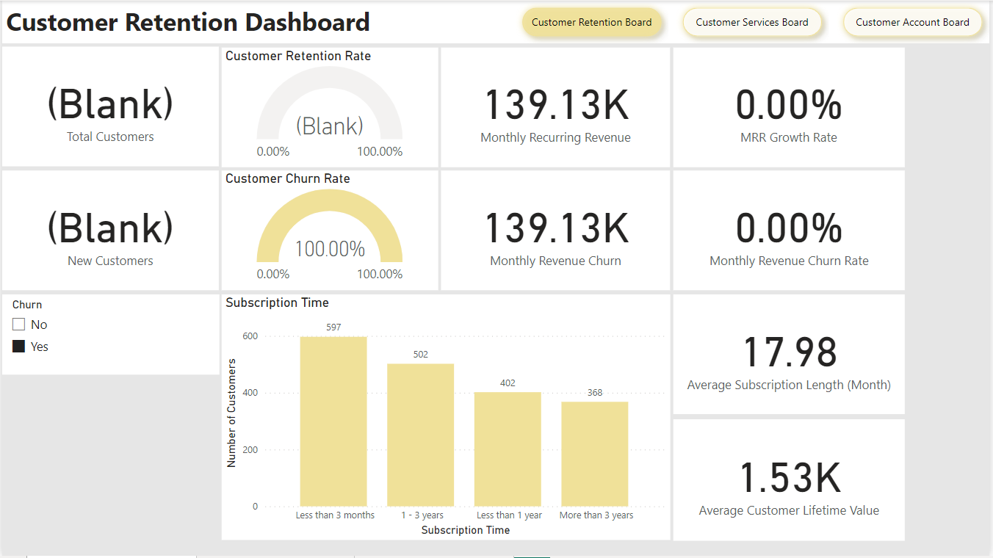
Data Insights
The average tenure rate is around 18 months while around 25% of current customers are in the range.
Last month, there was around 1850 customer churn.
600 (~30%) of them had a tenure of fewer than 3 months.
14

Slide 16
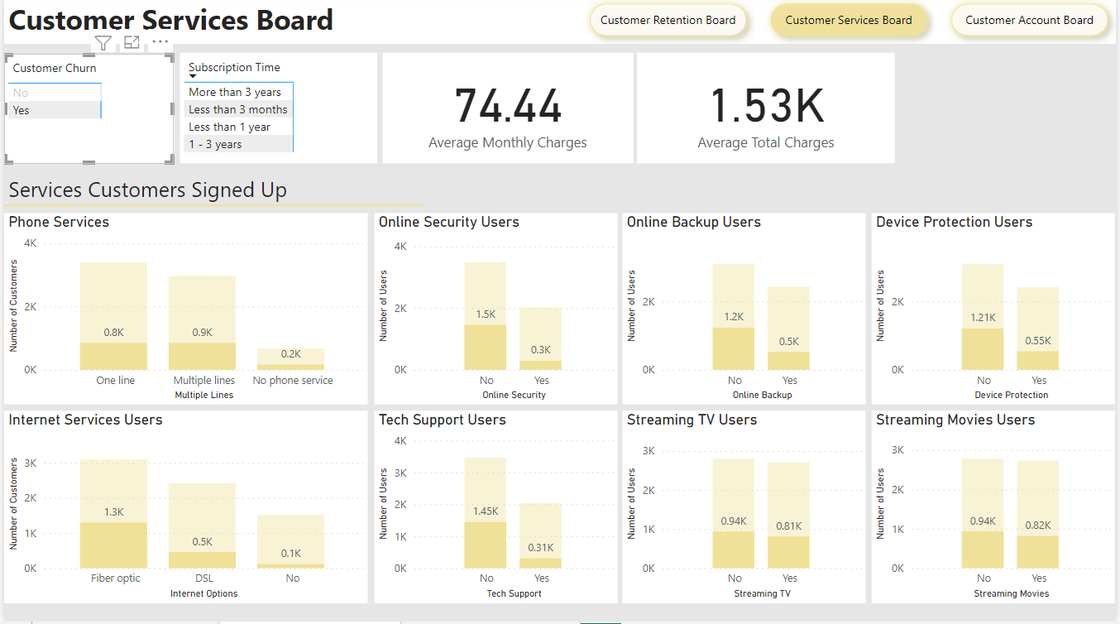
Data Insights
Observing services customers signed up for:
Around 1300 (~70%) of customer churn had signed up for fiber optic internet.
Most of the customer churn did not sign up for other internet services, except the streaming TV (~40%) and streaming Movies service (~40%).
15

Slide 17
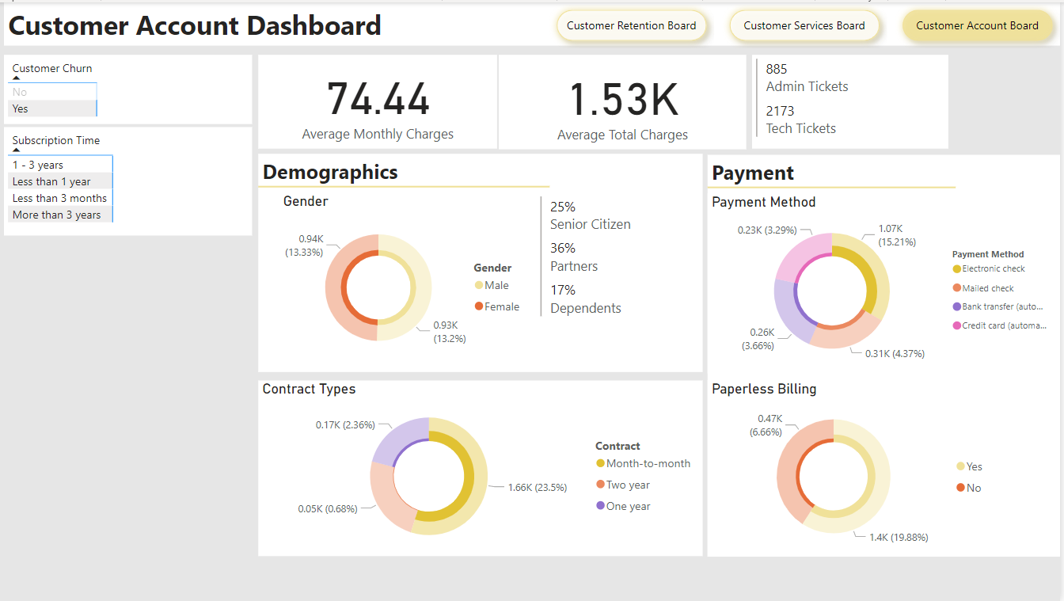
Data Insights
Observing customer account information:
Nearly all the customer churn (~90%) had a month-to-month contract.
Around 60% of customer churn paid with an electronic check.
Around 75% of customer churn used paperless billing.
16

Slide 18
Conclusion
Based on the above findings, I have the following suggestions for retention:
We can focus on the user experience of customers with a tenure of fewer than 3 months by having specialists conduct a phone survey.
We can check whether there were lots of problems with fiber optics got reported last month, such as connection failure or poor speed.
We can examine the content of streaming TV and movie lists in order to match the customers’ tastes.
We can offer a 1 or 2-year contract with a greater discount to the customers.
We can check whether there were lots of problems with paperless billing or electronic check got reported last month.
17

Slide 19
Task 3
Human Resources at PhoneNow is highly into diversity and inclusion. They’ve been working hard to improve gender balance at the executive management level, but they’re not seeing any progress. They’re reaching out to us for help.
Key stakeholders: HR Manager at PhoneNow, Giulia (my manager)
Business Tasks:
Define relevant KPIs in hiring, promotion, performance, and turnover, and create a visualization.
Think of the root causes of their slow progress might be.
18

Slide 20
Dashboard Elements
Based on the datasets the HR manager provided, I created the dashboard with 4 pages:
HR Metrics: Included KPIs
Organization
Employees Services Years
Employee Performance
19

Slide 21
Dashboard Elements
I defined the following KPIs:
# of men
# of women
# of leavers
% employees promoted (FY21)
% of women promoted
% of hires men
% of hires women
% turnover
Average performance rating: men
Average Performance rating: women
20

Slide 22
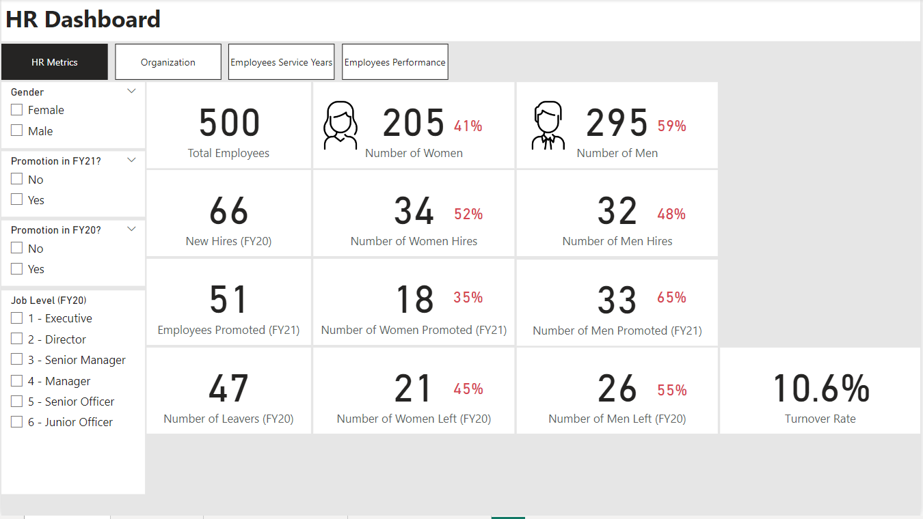
HR Metrics
21

Slide 23
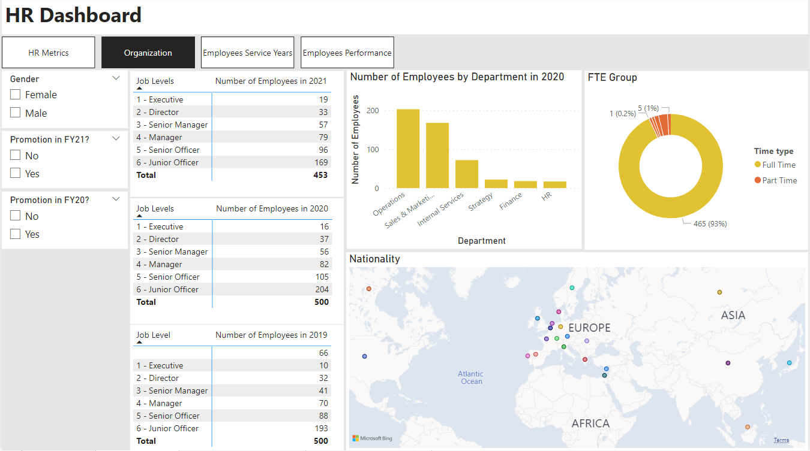
Organization
22

Slide 24
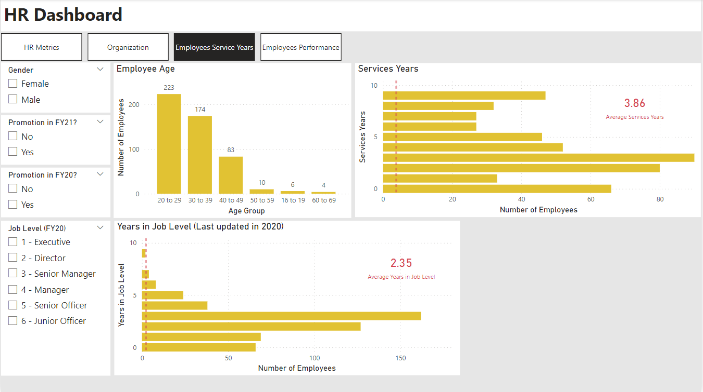
Employees Services Years
23

Slide 25
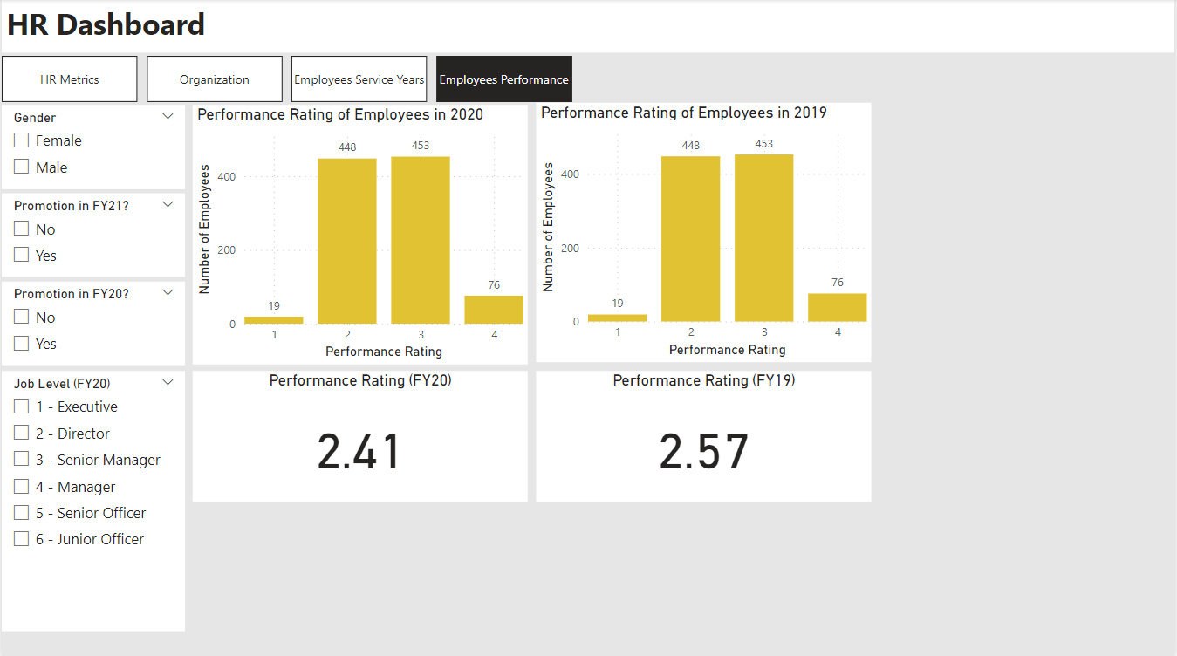
Employees Performance
24

Slide 26
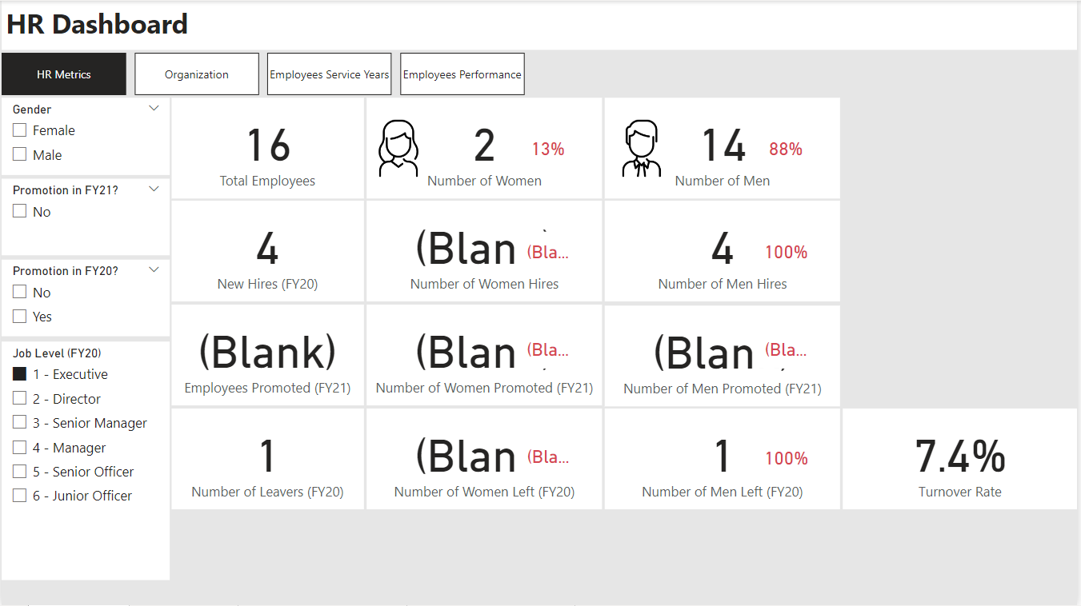
Data Insights
In FY20, there were 14 male executives and only 2 female executives.
4 male executives were hired while only 1 left.
14

Slide 27
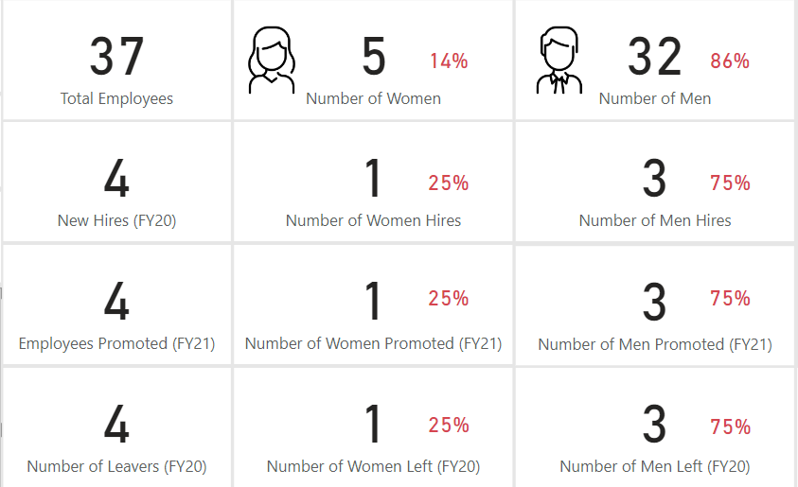
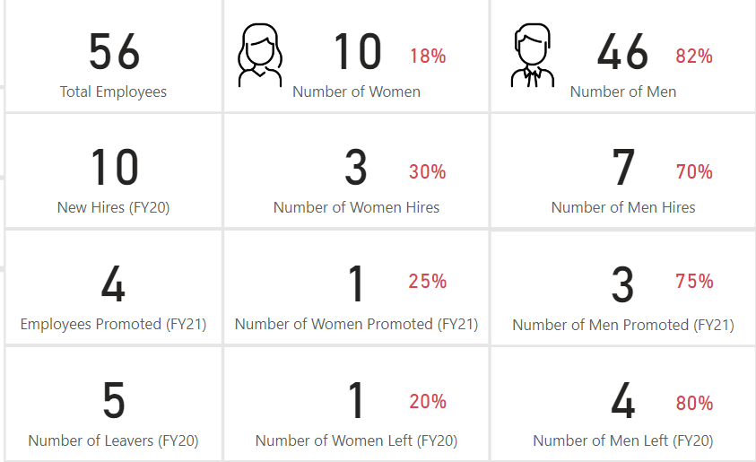
Data Insights
Directors
From the graphs, gender is not balanced at the director and senior manager levels as well.
Senior Managers
14

Slide 28
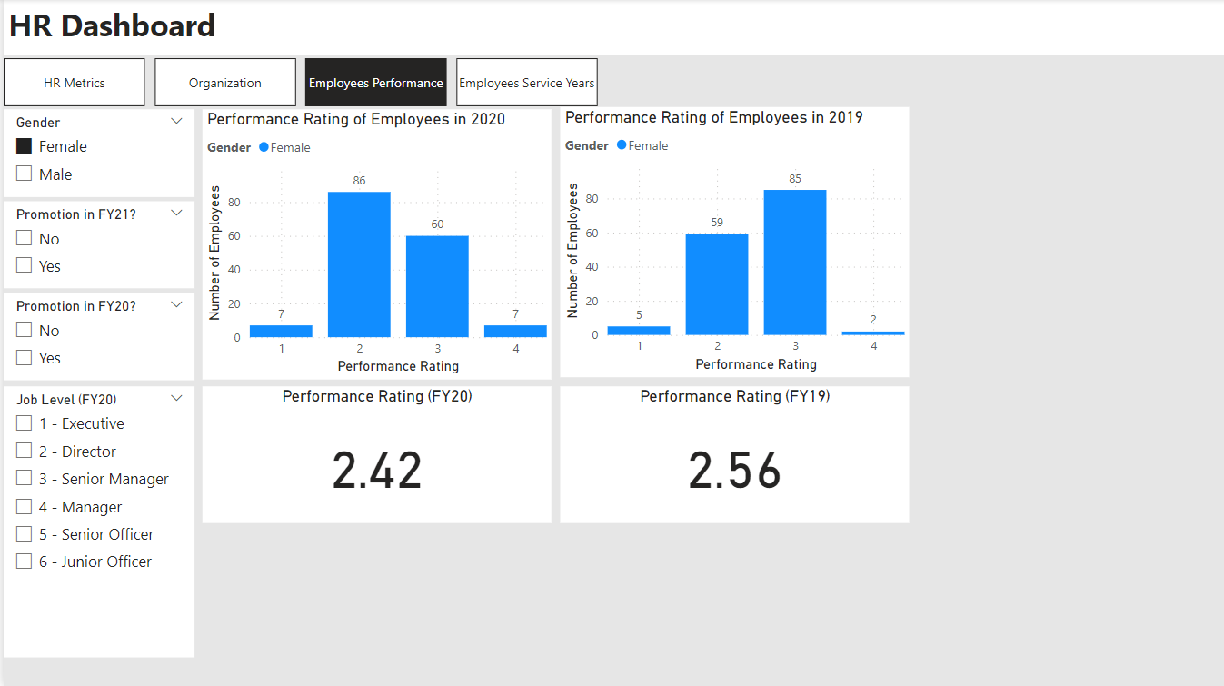
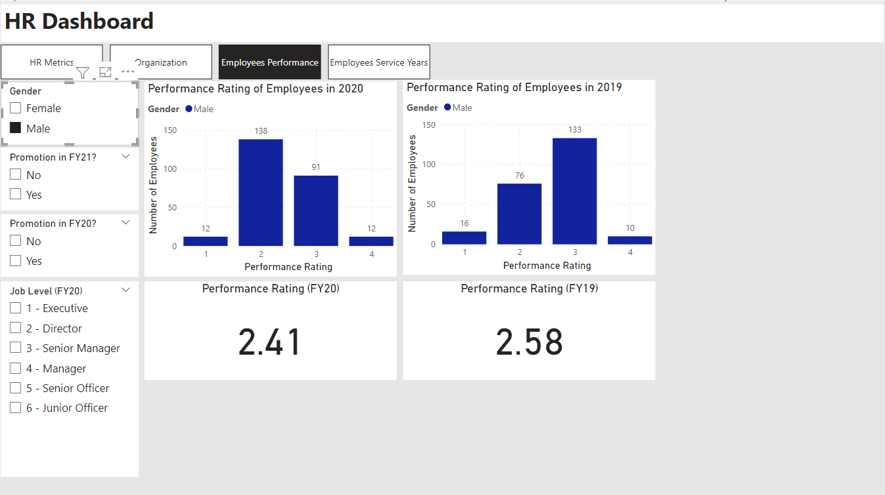
Data Insights
Female
Observing the performance rating in FY20 and FY19, both men and women had similar performance.
Male
14

Slide 29
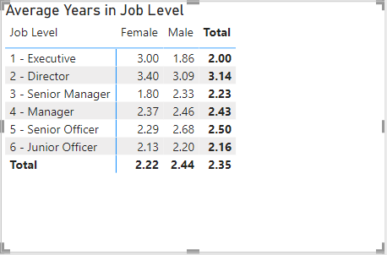
Data Insights
From the table, both male and female employees have similar years in the same job level.
14

Slide 30
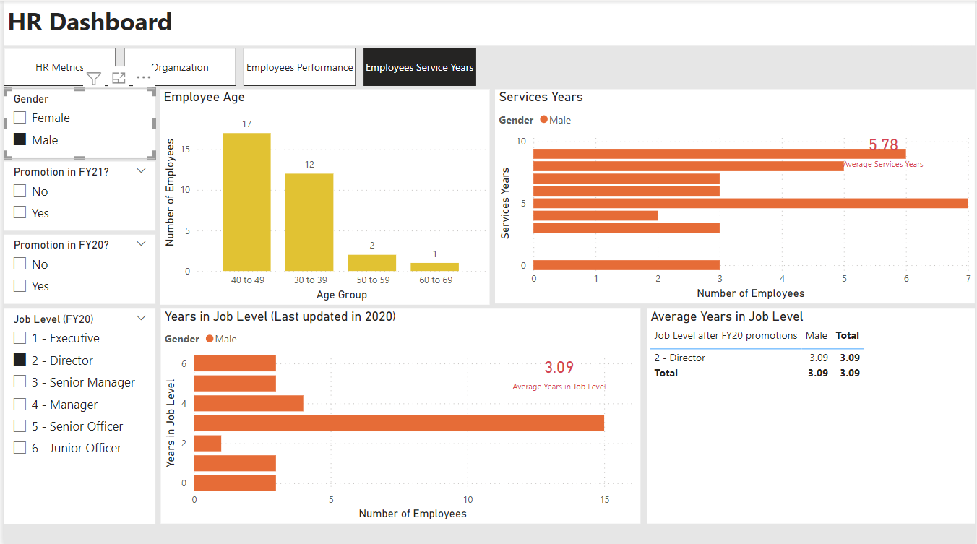
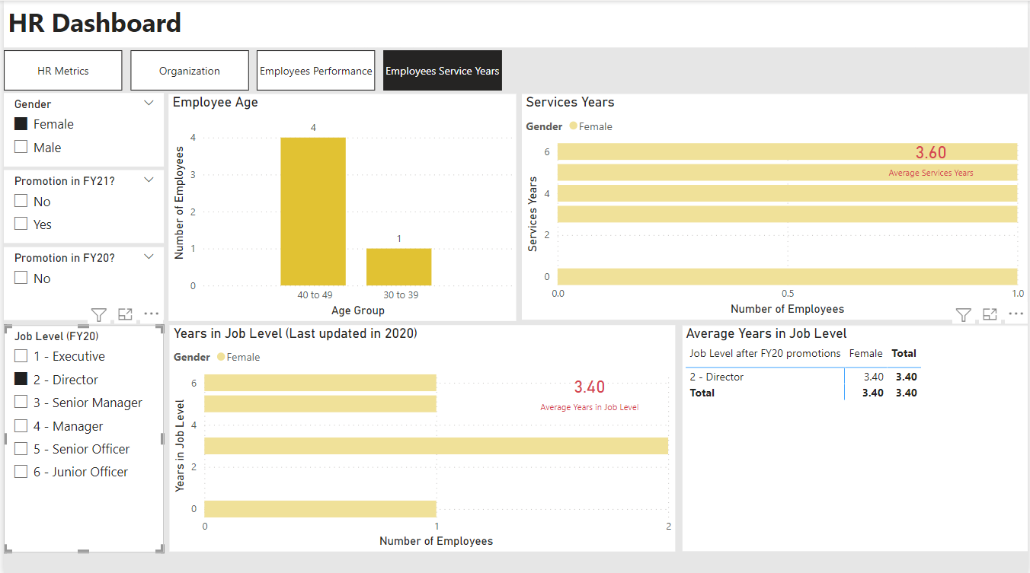
Data Insights
Male Directors
Management is more likely to promote a male because of their seniority.
Although they have similar years in director job level, the average service year for male directors is longer.
Female Directors
14

Slide 31
Conclusion
Based on the above findings, I have the following insights:
In FY20, 4 male executives were hired while only 1 left. It exaggerated the gender imbalance at the executive level.
At different levels, there are more male employees than female, except junior officers.
Both men and female have similar performance ratings.
From time to time, management is more likely to promote a male because of their seniority which leads to a more serious imbalance.
17

Slide 32
Conclusion
Based on the above data, I have the following ideas about their slow progress:
The database is confused that the values in the other sheets are not organized well.
With the current data collected, we can only discover that the gender imbalance is exaggerated because of new hires at the executive level in FY20.
However, we do not have any cues about the gender imbalance starting from management levels. It may be caused by an event a few years ago that no related data is given.
17

Slide 33

THANK YOU

